Slide 1

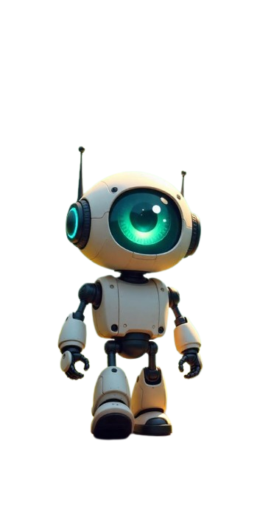
AURABOT
AURASAFE

Slide 2




AURASAFE
Introduction
INTRODUCTION
HARDWARE
Objective of project
Jetson nano integration
Motivation of project
AGENDA
Advantages
Intrusion detection
SOFTWARE
FUTURE SCOPE
Real time application
Blockchain integration
Business Model
Dashboard integration
Conclusion

Slide 3

INTRODUCTION
AURASAFE
"The Cyber Guardian of the Future—An AI That Fights Back!"
A cybersecurity revolution. An AI revolution. A revolution that redefines what it means to be secure in a world where cyberattacks are no longer a rare occurrence but a common occurrence.Imagine if I said to you that your networks are intelligent. That your security programs can learn. That your defenses can cure themselves—on their own?Because that's precisely what we have constructed.Meet the AI-Driven Quantum-Resistant Self-Healing Cyber Guardian ! This is more than an intrusion detection system.This is more than an AI firewall.This is an independent, self-protecting, self-healing AI guardian—designed to safeguard networks from today's threats and tomorrow's quantum-fueled threats.

Slide 4

AURASAFE
OBJECTIVE
ENHANCE NETWORK SECURITY
ENSURE DATA INTERGRITY AND TRANSPARENCY
IMPROVE INCIDENT RESPONSE
Identify and block unauthorized access, with real-time monitoring and response to threats.
Offer automated alerts and actionable insights to efficiently mitigate cyber threats and minimize response time.
Have a secure logging mechanism to keep an immutable record of intrusion attempts, enhancing trust and accountability.

Slide 5


AURASAFE
MOTIVATION OF THIS PROJECT
The surge in cyberattacks, such as unauthorized access, malware, and data breaches, has highlighted the shortcomings of conventional security. Lacking real-time intrusion detection, threats remain hidden until major damage has occurred, incurring losses in terms of money and data. Sensitive sectors like finance, healthcare, and government institutions are still much at risk because attackers use sophisticated methods like AI-fueled attacks and zero-day exploits

Slide 6

AURASAFE
Intrusion Detection
Overview
• Detects unauthorized access in real-time
• Integrates blockchain for secure logging
• Dashboard UI for monitoring & control
Key Feature
• AI-powered Intrusion Detection
• Live Threat Monitoring Dashboard
• Automated Intruder Mitigation
Tech Stack
• Jetson Nano (Edge AI)
• Blockchain (Tamper-proof logs)
• PyQt/ React (Interactive UI)
Impact
• Enhances cybersecurity
• Reduces false alarms
• Real-time risk prevention

Slide 7
AURASAFE
BLOCKCHAIN INTEGRATION
Overview
Our system detects unauthorized access in real-time, integrating AI-driven intrusion detection with TON blockchain for secure and tamper-proof logging. A live monitoring dashboard provides complete visibility and control over network security.
Core Feature
Our system merges AI intrusion detection with TON blockchain for secure logging, featuring quantum encryption and a self-healing mechanism for automated threat mitigation. Running on Jetson Nano, it ensures real-time monitoring and protection.
Tech Stack
Our system integrates AI-powered intrusion detection with TON blockchain for tamper-proof security logging. Quantum encryption secures communication, while a self-healing mechanism automates threat mitigation and recovery. Running on Jetson Nano, it ensures real-time monitoring and protection.
This solution enhances cybersecurity by reducing false alarms, ensuring real-time risk prevention, and providing a scalable, secure framework for enterprises, IoT, and cloud security applications.

Slide 8

AURASAFE
DashBoard Integration
Dashboard Integration
• React + Flask → Web-based UI
• PyQt→ Native touchscreen UI
• Matplotlib→ Data visualization
Core Features
• Live Intrusion Alerts
• Threat Analysis Graphs
• Blockchain-Backed Logs
• Intruder Mitigation Controls
Tech Stack
• Frontend: HTML/ Java Script.
• Backend: Flask / FastAPI
• Visualization: CSS
(Cascading Style Sheets)

Slide 9
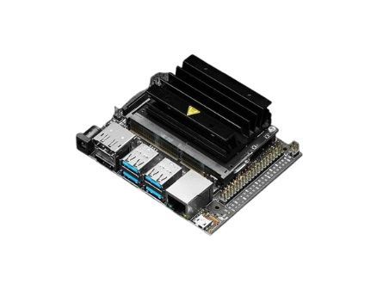
AURASAFE
Hard Ware
JETSON NANO INTEGRATION
Jetson Nano Specifications:
Jetson Nano is an embedded AI computing device developed by NVIDIA, designed for edge AI applications with high efficiency and low power consumption.
1. Hardware Specifications:
CPU: Quad-core ARM Cortex-A57 (64-bit)
GPU: 128-core Maxwell GPU with CUDA support
Memory: 4GB LPDDR4 (25.6 GB/s bandwidth)
Storage: microSD card slot (supports up to 128GB)

Slide 10
AURASAFE
Connectivity:
Gigabit Ethernet (RJ-45)
4 x USB 3.0 ports
HDMI and DisplayPort support
MIPI CSI camera interface
Power:
5V/4A DC Barrel Jack or Micro-USB (5V/2A)
Power modes: 5W and 10W
I/O Ports:
40-pin GPIO Header (Raspberry Pi compatible)
I2C, I2S, UART, SPI, and PWM support
2. Software Support:
Operating System: Ubuntu-based NVIDIA JetPack SDK (includes CUDA, cuDNN, TensorRT, OpenCV, and DeepStream)

Slide 11
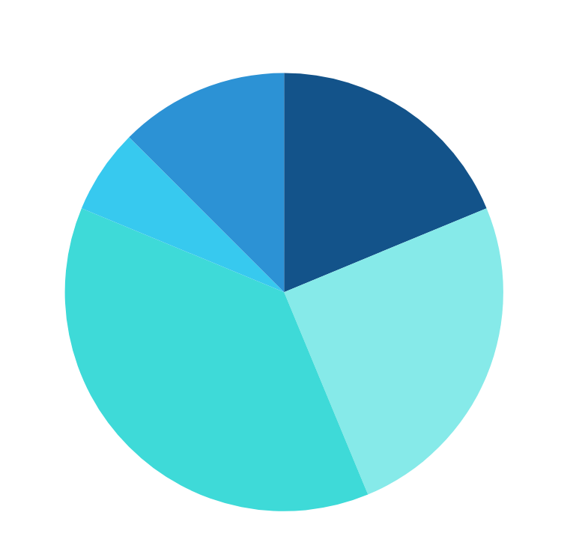
FUTURE SCOPE
AURASAFE
ADVANTAGES
The future scope of this Intrusion Detection System (IDS) with Blockchain Integration includes AI-powered threat analysis for smarter intrusion detection, IoT security integration for smart homes and industries, and a hybrid cloud-edge model for enhanced security analytics. It can evolve into an automated threat response system and a global blockchain-based security network for real-time threat intelligence sharing
North Fortberry
Grayerville
Rainbow Clove

Slide 12
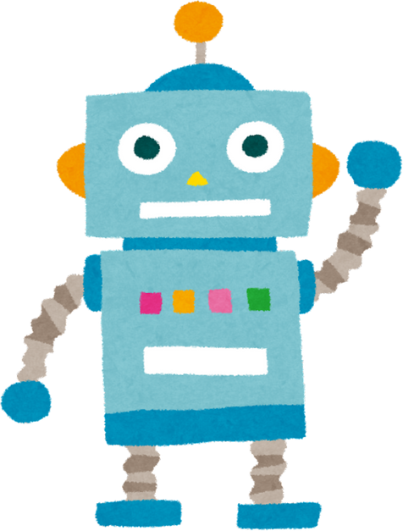

BUSINESS MODEL
AURASAFE
The blockchain and AI-based intrusion detection system is highly demanded due to growing cyber attacks in sectors such as finance, healthcare, and critical services. Its key advantages are employing AI for detecting abnormal behavior, blockchain for secure and immutable security logs, and a self-healing mechanism for automatic repair. The average cost is associated with high upfront development costs but low recurring expenses. There is high potential for generating revenue through subscription models, business licensing, and managed security services. It can scale quickly, supporting small devices such as Jetson Nano and large cloud infrastructures, and is thus an effective cybersecurity solution for enterprises.

Slide 13
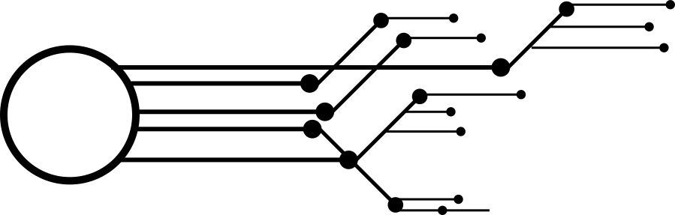
AURASAFE
REAL TIME APPLICATION
Enterprise Security – Protects company networks from cyber threats.
Banking & Finance – Detects fraud & unauthorized transactions.
Smart Homes & IoT – Secures smart devices from hacking.
Automotive Security – Prevents cyberattacks on connected cars.
Government & Defense – Safeguards critical networks from cyber espionage.
Cloud Security – Protects AWS, Azure & Google Cloud from attacks.
Healthcare – Ensures patient data security & medical device protection.

Slide 14

AURASAFE
CONCLUSION
Intrusion Detection Systems (IDS) play a crucial role in cybersecurity.
They monitor, detect, and prevent unauthorized access in real time.
Integration with AI, Blockchain, and Cloud Security enhances protection.
Used in banking, healthcare, IoT, defense, and enterprise networks.
Future Scope: Advanced AI-driven threat prediction & automated mitigation.
A secure network is a resilient network!

Slide 15
THANK YOU !
AURASAFE

